Slide 1

Team Name :
Team Leader Name :
Problem Statement :

Slide 2

Team Members
Team Leader: Name: College: | Team Member-1: Name: College:
Team Member-2: Name: College: | Team Member-3: Name: College:

Slide 3
Brief of the idea
The Forest Fire Simulation project models the spread of fire through a forest grid using a computational algorithm. Each cell in the grid represents a part of the forest that can be in one of several states—such as empty, tree, or burning. The simulation progresses step-by-step, showing how fire spreads based on defined rules and conditions like wind, moisture, and tree density. This visual and dynamic model helps in studying fire behavior and evaluating how quickly a fire can grow under different scenarios, making it a useful tool for awareness, analysis, and potential disaster preparedness planning.

Slide 4
Opportunity should be able to explain the following:
1. How is it different from other existing ideas?
While many existing forest fire models focus on complex real-time prediction using satellite data or require high computational power, this simulation emphasizes simplicity, interactivity, and educational value. It provides a grid-based, rule-driven approach that can be easily customized and visualized in real-time, making it accessible to learners, researchers, and planners without requiring deep technical infrastructure or external data feeds.
2. How does it solve the problem?
This simulation addresses the problem of understanding and visualizing fire spread in a controllable environment. By allowing users to adjust factors such as tree density, wind direction, and moisture levels, it enables better comprehension of how fires behave under different conditions. This can assist in:
Educating the public and students on fire dynamics
Helping planners and researchers experiment with scenarios
Supporting early-stage decision-making and training simulations
3. Unique Selling Proposition (USP)
Simplicity & Accessibility: Easy to run and understand without the need for complex geographic data.
Customization: Parameters like wind, humidity, and ignition points can be altered to test various scenarios.
Visualization: Offers an intuitive and dynamic visual output, helping users instantly grasp the effects of environmental factors.
Educational Value: Ideal for academic projects, awareness campaigns, and preliminary risk assessments.

Slide 5
List Of Key Features
1.Forest Fire Probability Mapping
Predicts next-day fire probability for selected regions.
Generates binary risk maps: High Risk / Low/No Risk.
2.Fire Spread Simulation
Simulates fire propagation using cellular automata or FARSITE.
Considers wind speed/direction, terrain, slope, and fuel type.
3.Real-Time Visualization
Displays dynamic, step-by-step spread of fire.
Helps analyze and compare different fire scenarios.
4.Customizable Parameters
Supports adjustments for moisture, tree density, and weather conditions.
5.Awareness & Planning Tool
Useful for risk analysis, educational use, and disaster preparednes

Slide 6
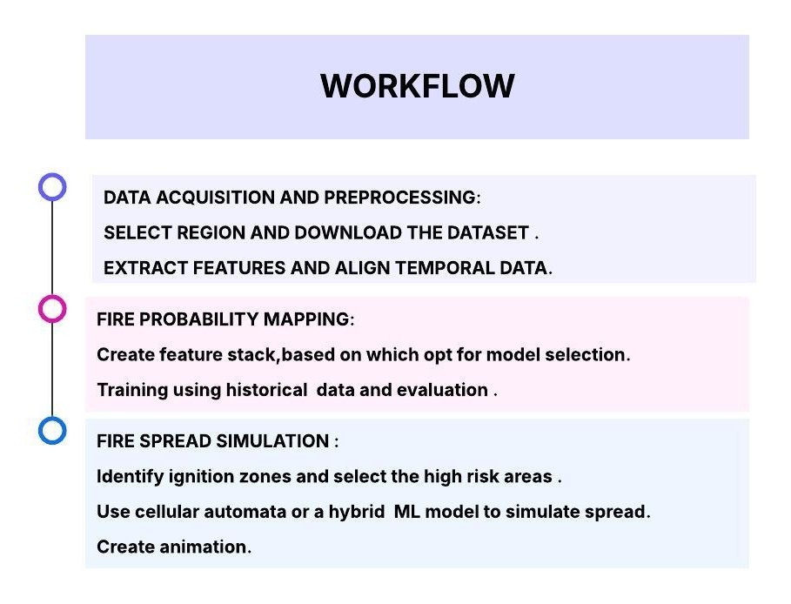
Process flow diagram or Use-case diagram

Slide 7
Wireframes/Mock diagrams of the proposed solution (optional)

Slide 8
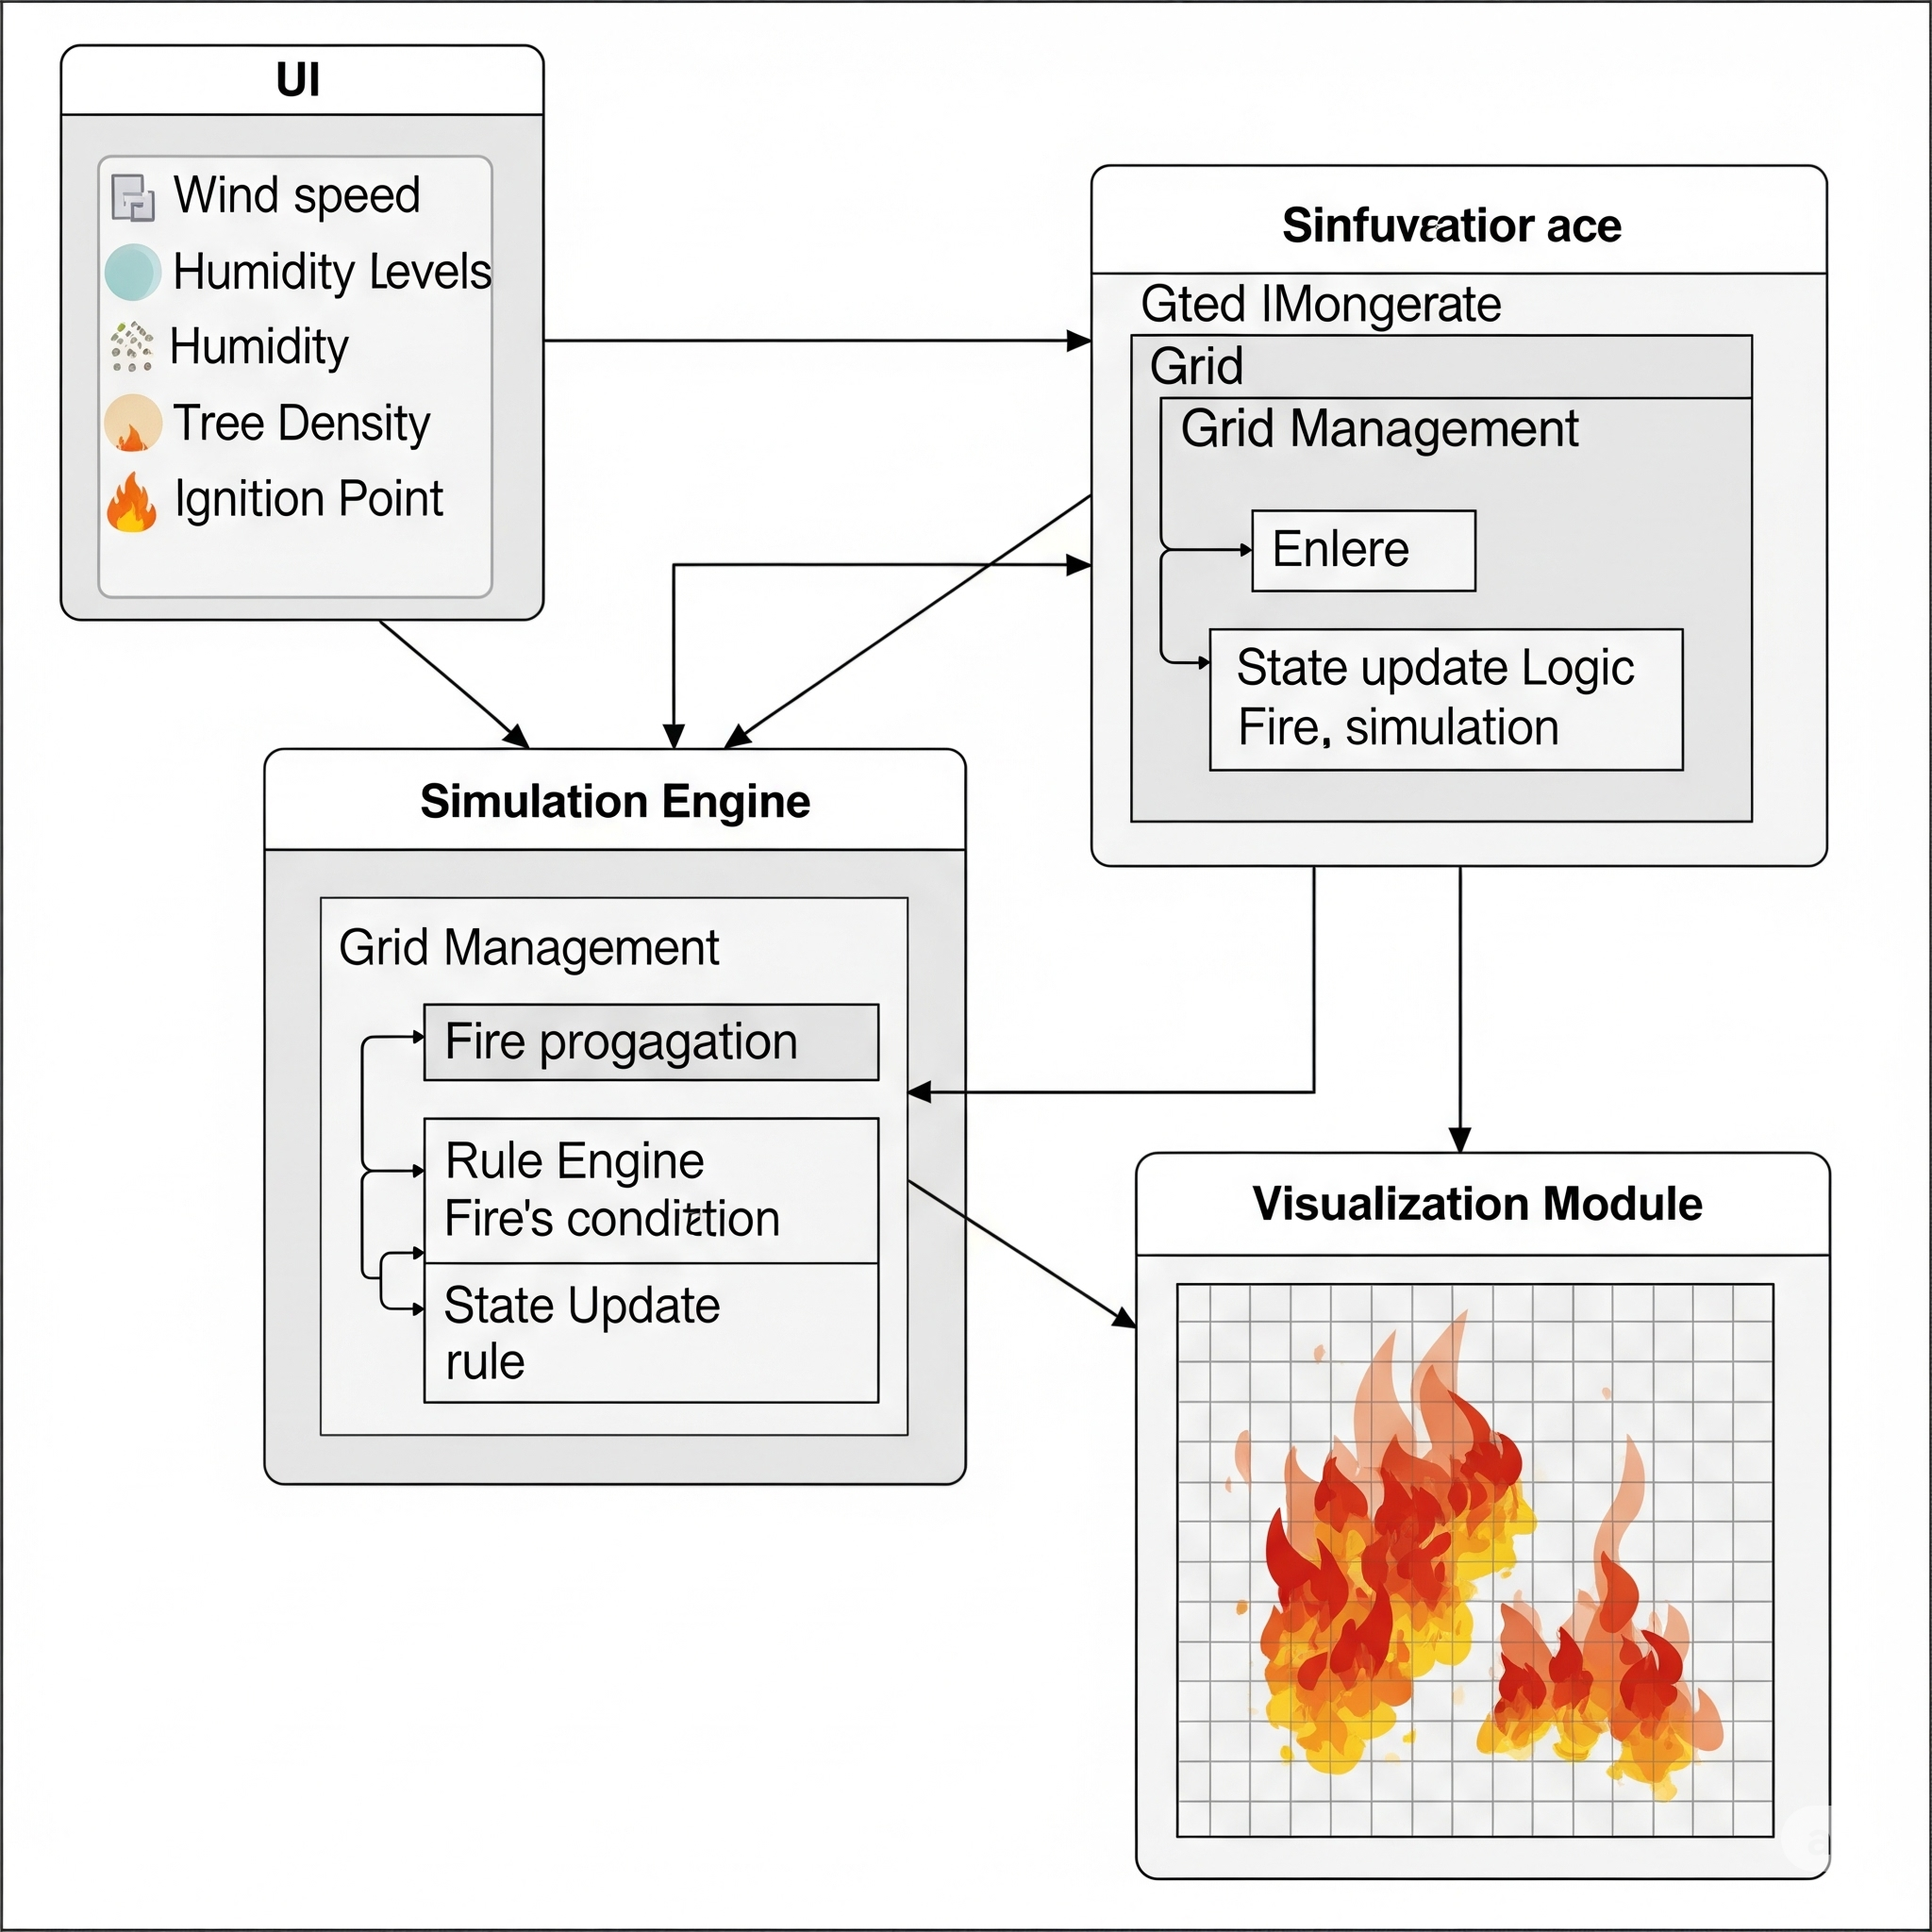
Architecture diagram of the proposed solution
User Interface (UI): This is where users interact with the simulation, input parameters, and view the results.
Input Parameters: These include configurable factors like wind speed, humidity levels, tree density of the fire
Simulation Engine: This is the core logic. It comprises:
Grid Management: Handles the 2D grid structure, storing the state of each cell (empty, tree, burning).
Rule Engine: Applies the predefined rules for how fire spreads based on the input parameters.
State Update Logic: Updates the state of the cells in the grid for each time step of the simulation.
Visualization Module: This component takes the updated grid data from the Simulation Engine and renders it visually on the User Interface, allowing users to see the fire spread in real-time

Slide 9
Technologies to be used in the solution:

Slide 10
Estimated implementation cost :
Component | Details | Estimated Cost (INR)
Development Tools & Software | Python, Pygame, Matplotlib, NumPy (Free & Open Source) | ₹0
Design Tools (optional) | Canva, Figma (free version) | ₹0
Team Effort | 3–4 members × ~15 hours (learning + coding + testing) | Non-monetary (student effort)
Hosting (optional demo deployment) | Heroku / Render / GitHub Pages / Firebase | ₹500 – ₹1000

Slide 12


